Slide 1
Development of Sensor for diagnosis of Vitamin-D
By :
Vikash Nirwan
Chammandi Ravi Kiran

Slide 2
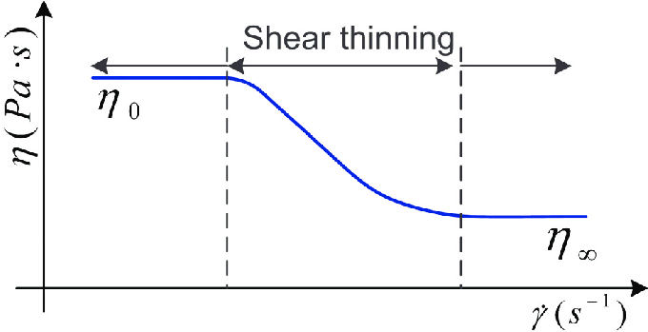
What is shear-thinning fluid
Shear thinning is a phenomenon characteristic of some non-Newtonian fluids in which the fluid viscosity decreases with increasing shear stress. Shear thickening is the opposite phenomenon. (By contrast to both, viscosity in Newtonian fluids is by definition independent of the forces exerted on the fluid.) Fluids that exhibit shear thinning are sometimes called pseudoplastics and are typically complex fluids such as blood, motor oil, ketchup, and even whipped cream, though simple fluids can also exhibit the behavior near their critical point.

Slide 3
Introduction
We have investigated the plane poiseuille flow of shear-thinning fluid (Carreau model is considered). A set of governing equations are taken and converted into dimensionless form for the analysis. The starring role of heat transfer, magnetic field and porosity are all together taken into account. The effectual reliability of analytical solutions derived by homotopy analysis method is verified through various graphs. Impact of physical factors is examined via graphs.

Slide 4
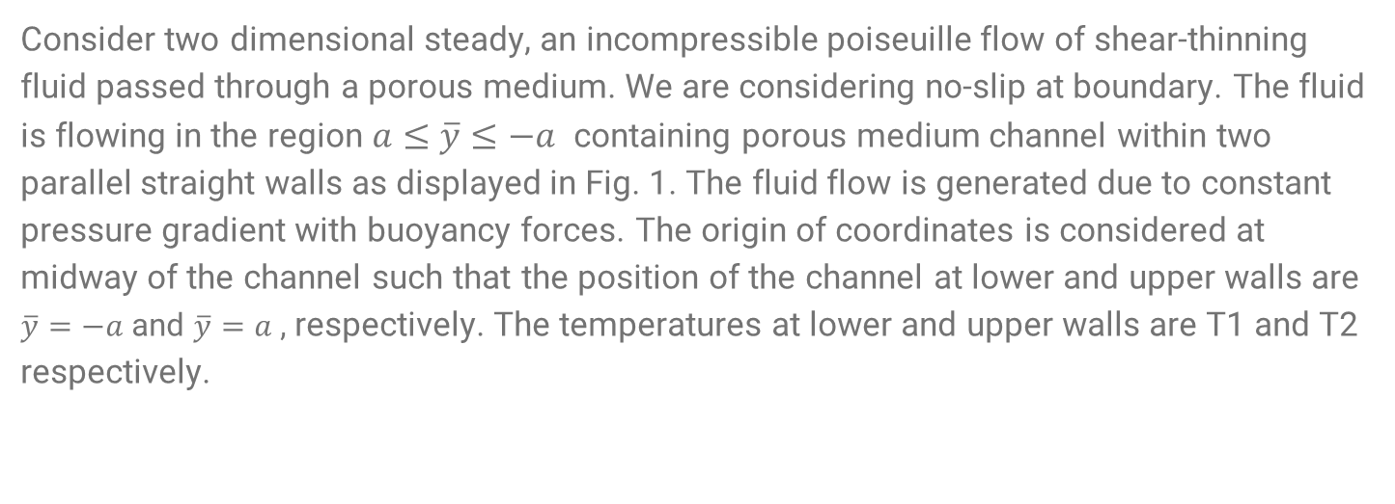
Problem Formulation
Consider two dimensional steady, an incompressible poiseuille flow of shear-thinning fluid passed through a porous medium. We are considering no-slip at boundary. The fluid is flowing in the region $a≤\overline{y}≤−a$ containing porous medium channel within two parallel straight walls as displayed in Fig. 1. The fluid flow is generated due to constant pressure gradient with buoyancy forces. The origin of coordinates is considered at midway of the channel such that the position of the channel at lower and upper walls are $\overline{y}=−a$ and $\overline{y}=a$ , respectively. The temperatures at lower and upper walls are T1 and T2 respectively.

Slide 5
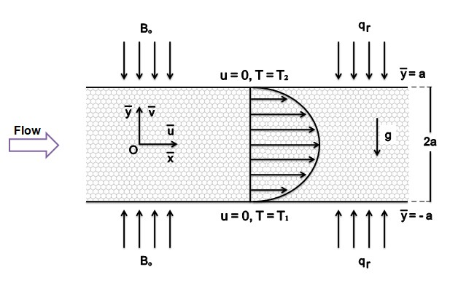
Required figure for the problem

Slide 6
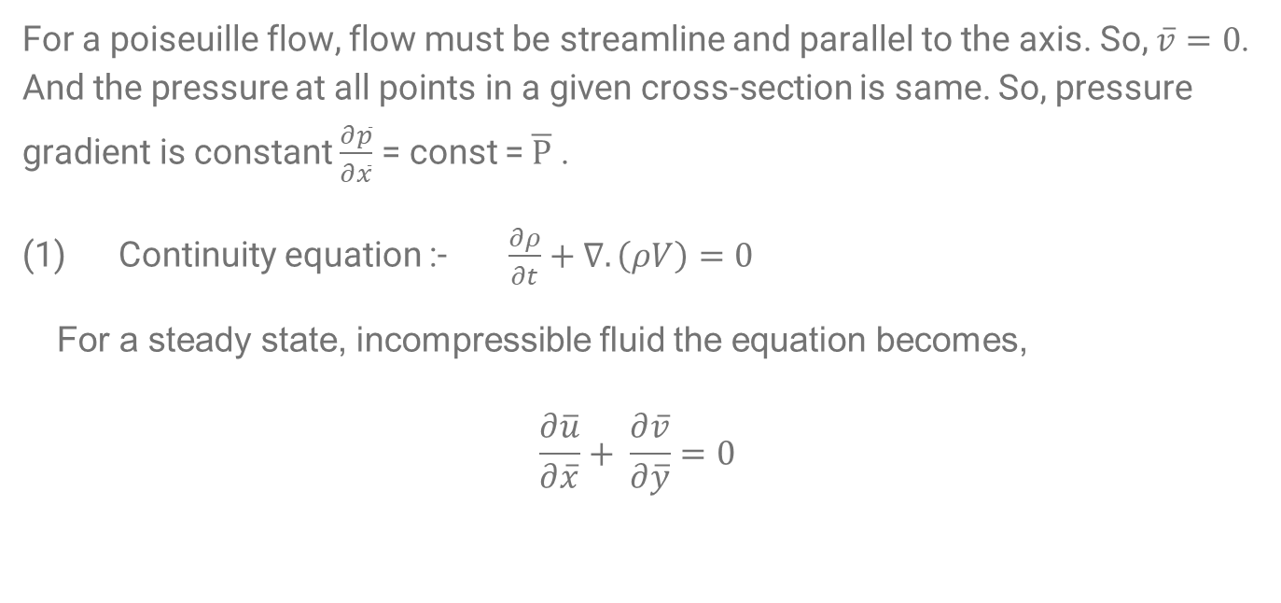
Governing equations used to solve the problem
For a poiseuille flow, flow must be streamline and parallel to the axis. So, $\overline{v}=0$. And the pressure at all points in a given cross-section is same. So, pressure gradient is constant $\frac{∂\overline{p}}{∂\overline{x}}$ = const =$\overline{P}$ .
Continuity equation :- $\frac{∂ρ}{∂t}+∇.\left(ρV\right)=0$
For a steady state, incompressible fluid the equation becomes,
$$\frac{∂\overline{u}}{∂\overline{x}}+ \frac{∂\overline{v}}{∂\overline{y}}=0$$

Slide 7
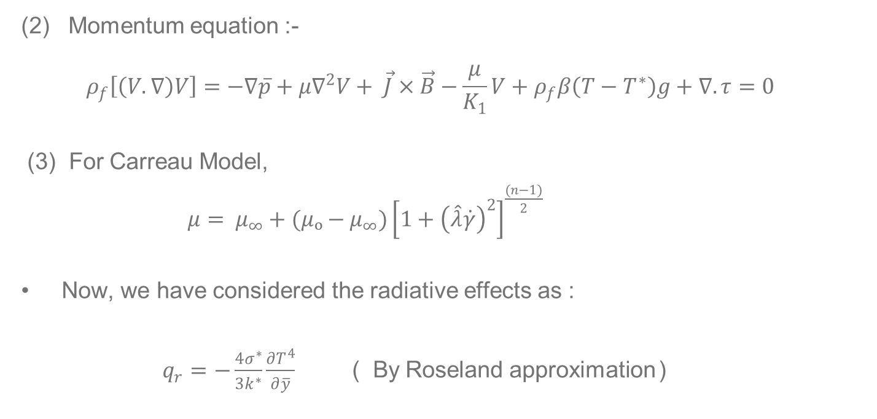
(2) Momentum equation :-
$$ρ_{f}\left[\left(V.∇\right)V\right]=−∇\overline{p}+μ∇^{2}V+ \vec{J}×\vec{B}−\frac{μ}{K_{1}}V+ρ_{f}β\left(T−T^{∗}\right)g+∇.τ=0$$
(3) For Carreau Model,
$μ= μ_{∞}+(μₒ−μ_{∞}){\left[1+{\left(\hat{λ}\dot{γ}\right)}^{2}\right]}^{\frac{(n−1)}{2}}$
Now, we have considered the radiative effects as :
$q_{r}=−\frac{4σ^{∗}}{3k^{∗}}\frac{∂T^{4}}{∂\overline{y}}$ ( By Roseland approximation )

Slide 8
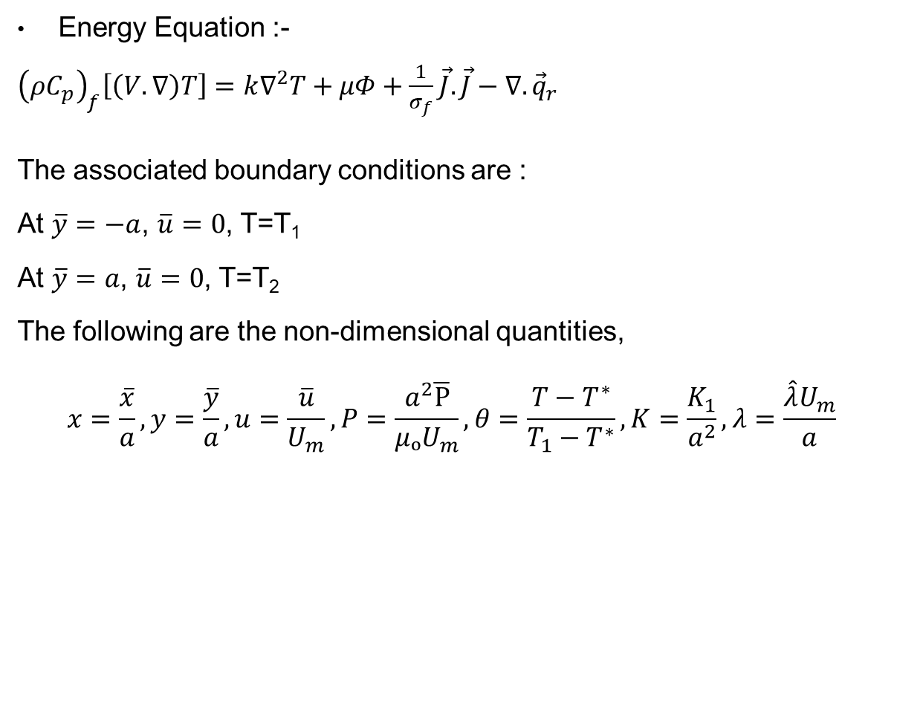
Energy Equation :-
${\left(ρC_{p}\right)}_{f}\left[\left(V.∇\right)T\right]=k∇^{2}T+μΦ+\frac{1}{σ_{f}}\vec{J}.\vec{J}−∇.{\vec{q}}_{r}$
The associated boundary conditions are :
At $\overline{y}=−a$, $\overline{u}=0$, T=T₁
At $\overline{y}=a$, $\overline{u}=0$, T=T₂
The following are the non-dimensional quantities,
$$x=\frac{\overline{x}}{a}, y=\frac{\overline{y}}{a}, u=\frac{\overline{u}}{U_{m}}, P=\frac{a^{2}\overline{P}}{μₒU_{m}}, θ=\frac{T−T^{∗}}{T_{1}−T^{∗}}, K=\frac{K_{1}}{a^{2}}, λ=\frac{\hat{λ}U_{m}}{a}$$

Slide 9

Where, x and y are non-dimensional components, u is x component of dimensionless velocity, m is temperature scale, P is dimensionless pressure gradient, 𝜃 is dimensionless temperature, 𝜆 is dimensionless time constant, $U_{m}$ is the maximum velocity of fluid that occurs between two walls.
Using the above non-dimensional quantities we can get dimension-less form of equations as :
$$−P+2\left[1+(n−1){\left(λ\frac{∂u}{∂y}\right)}^{2}\right]\frac{∂²u}{∂y²}−\left[M+\frac{1+\left(\frac{n−1}{2}\right){\left(λ\frac{∂u}{∂y}\right)}^{2}}{K}\right]u+ \frac{Ra}{RePr}θ=0$$
$\left(1+Rd\right)\frac{∂^{2}θ}{∂y^{2}}+ EcPr\left[1+\left(\frac{n−1}{2}\right){\left(λ\frac{∂u}{∂y}\right)}^{2}\right]{\left(\frac{∂u}{∂y}\right)}^{2}+ MPrEc u^{2}=0$

Slide 10

Here , $M=\frac{{ σ}_{f}{Bₒ}^{2}a^{2}}{μₒ}, Ra=\frac{\left(T_{1}−T^{∗}\right)βga^{3}}{θα}, Re=\frac{aU_{m}}{θ}, Pr=\frac{θ}{α}, Rd=\frac{16σ^{∗}{T^{∗}}^{3}}{3k^{∗}{\left(ρC_{p}\right)}_{f}α}, Ec=\frac{{U_{m}}^{2}}{C_{p}\left(T_{1}−T^{∗}\right)}$
Nomenclature :
$\overline{v}$ = velocity vector $μₒ$ = Zero shear rate viscosity
$μ_{∞}$ = Infinite shear rate viscosity $\dot{γ}$ = Shear rate
$n$ = Power law index $u$= Apparent viscosity
$\vec{B }$= Magnetic field vector $\vec{J}$ = Current density
$K_{1}$ = Porous medium permeability $k$ = Thermal conductivity
$β$ = Volumetric expansion coefficient $Φ$ = Viscous dissipation
$q_{r}$= Radiative heat flux $T^{∗}$ = Mean value temperature
$C_{p}$= Specific heat capacity $ρ_{f}$ = Density of fluid

Slide 11
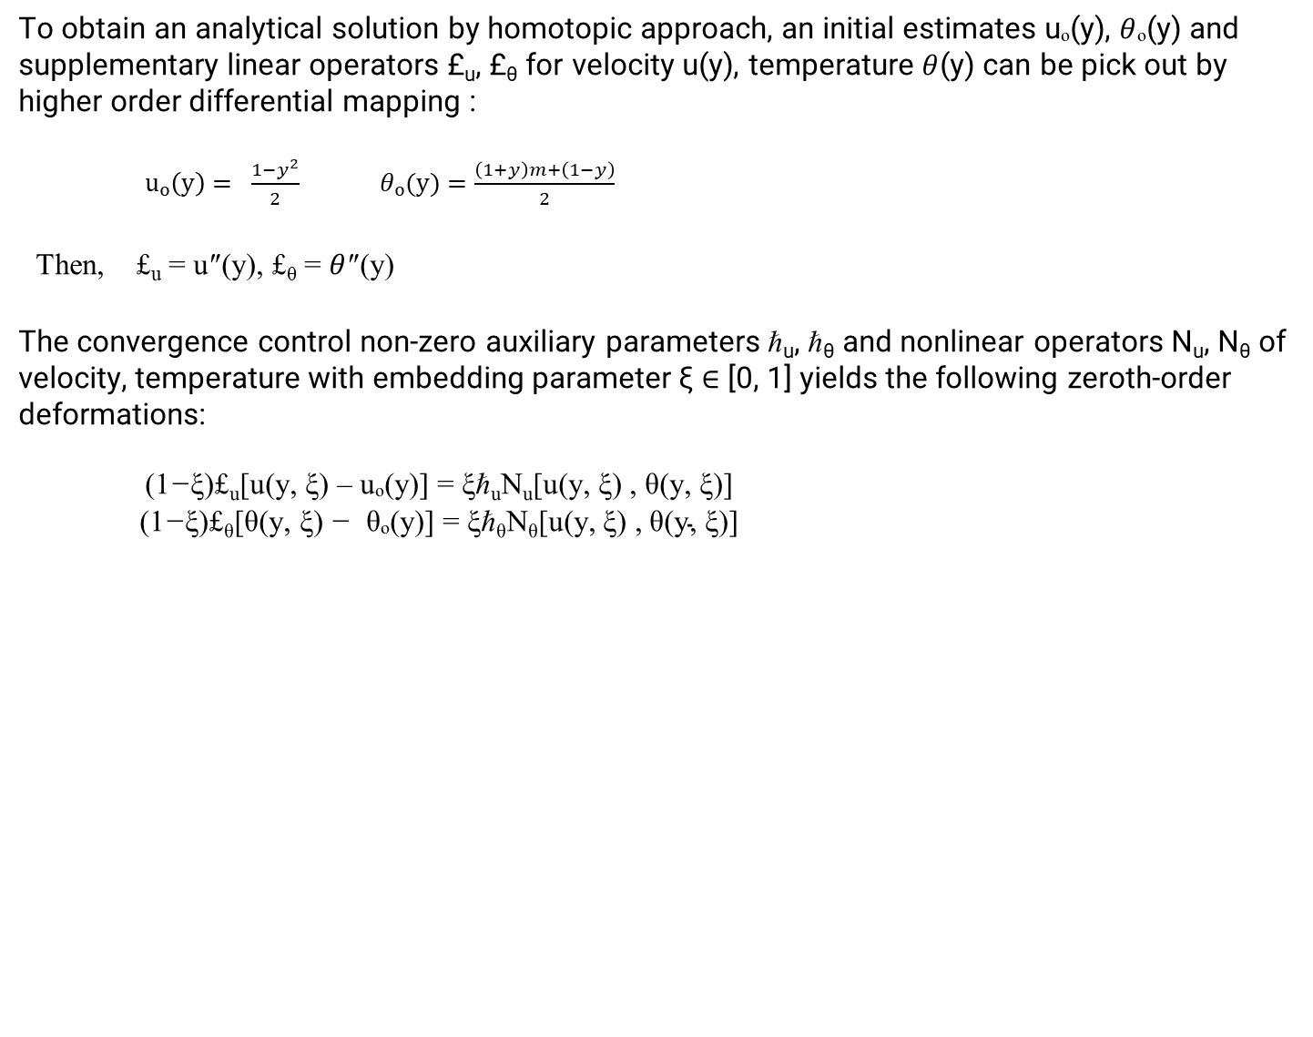
Approximate Analytic Solutions
To obtain an analytical solution by homotopic approach, an initial estimates uₒ(y), $θ$ₒ(y) and supplementary linear operators £_{u}, £_{θ} for velocity u(y), temperature $θ$(y) can be pick out by higher order differential mapping :
$uₒ\left(y\right)= \frac{1−y^{2}}{2}$ $θₒ(y)=\frac{\left(1+y\right)m+\left(1−y\right)}{2}$
Then, £_{u} = u″(y), £_{θ} = $θ$″(y)
The convergence control non-zero auxiliary parameters ℏ_{u}, ℏ_{θ} and nonlinear operators N_{u}, N_{θ} of velocity, temperature with embedding parameter ξ ∈ [0, 1] yields the following zeroth-order deformations:
$\begin{aligned}\text{(}\text{1}\text{−}\text{ξ}\text{)}\text{£}\text{u}\text{[}\text{u}\text{(}\text{y}\text{, }\text{ξ}\text{) }\text{– }\text{u}\text{ₒ(}\text{y}\text{)] = }\text{ξ}\text{ℏ}\text{u}\text{N}\text{u}\text{[}\text{u}\text{(}\text{y}\text{, }\text{ξ}\text{) , }\text{θ}\text{(}\text{y}\text{, }\text{ξ}\text{)] } \\ \text{(}\text{1}\text{−}\text{ξ}\text{)£}\text{θ}\text{[}\text{θ}\text{(}\text{y}\text{, }\text{ξ}\text{) }\text{−} \text{θ}\text{ₒ(}\text{y}\text{)] = }\text{ξ}\text{ℏ}\text{θ}\text{N}\text{θ}\text{[}\text{u}\text{(}\text{y}\text{, }\text{ξ}\text{) , }\text{θ}\text{(}\text{y}\text{, }\text{ξ}\text{)] }\end{aligned}$

Slide 12

Here we have,
$\begin{aligned} For ξ=0, u\left(y, ξ\right)= uₒ\left(y\right), θ\left(y, ξ\right)= θₒ\left(y\right) \\ For ξ=1, u\left(y, ξ\right)= u\left(y\right), θ\left(y, ξ\right)= θ\left(y\right)\end{aligned}$
With
$\begin{aligned}\text{N}\text{u}=−P+2\left[1+\left(n−1\right){\left(λ\frac{∂u\left(y,ξ\right)}{∂y}\right)}^{2}\right]\frac{∂^{2}u\left(y,ξ\right)}{∂y^{2}}−\left[M+\frac{1+\left(\frac{n−1}{2}\right){\left(λ\frac{∂u\left(y,ξ\right)}{∂y}\right)}^{2}}{K}\right]u\left(y,ξ\right)+ \frac{Ra}{RePr}θ\left(y,ξ\right) \\ \text{N}\text{θ}=\left(1+Rd\right)\frac{∂^{2}θ(y,ξ)}{∂y^{2}}+ EcPr\left[1+\left(\frac{n−1}{2}\right){\left(λ\frac{∂u(y,ξ)}{∂y}\right)}^{2}\right]{\left(\frac{∂u(y,ξ)}{∂y}\right)}^{2}+ MPrEc({u(y,ξ))}^{2}\end{aligned}$
The approximated solutions up to kth‐order approximation are expressed as:
$\begin{aligned}u\left(y, ξ\right)= uₒ\left(y\right)+ \sum_{l=1}^{k}{u_{l}\left(y\right)}ξ^{l} \\ θ\left(y, ξ\right)= θₒ\left(y\right)+ \sum_{l=1}^{k}{θ_{l}\left(y\right)ξ^{l}}\end{aligned}$

Slide 13
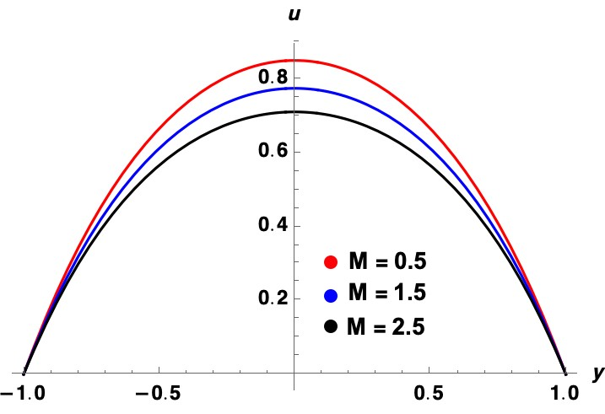

Results
Figure 2(a) is drawn to analyze velocity profile distribution with the consideration of zero velocity slip for various Magnetic parameter (M) values with fixed values of n=2, $λ$=0.2, K=0.2, m=0, Ra=1, Re=1, Rd=0.1, Ec=0.01, Pr=1, P= -5. Retardation occurs on velocity profile as shown in Fig. 2(a), because of the fact that Magnetic field is acted normally to flow direction in the absence of slip parameters.
Fig. 2(a)

Slide 14
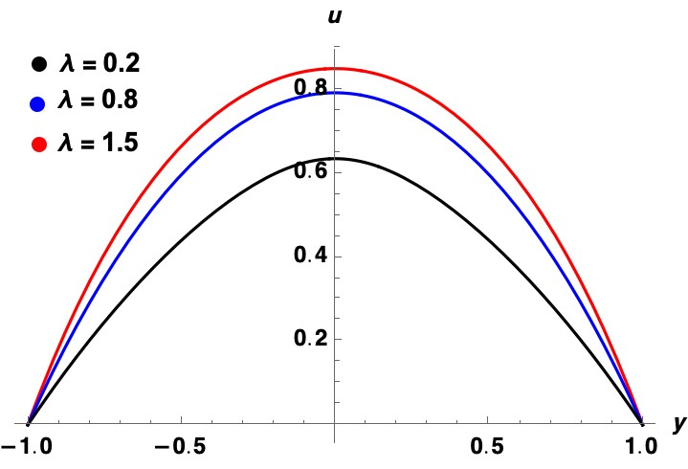

Figure 2(b) is drawn to analyze velocity profile distribution with the consideration of zero velocity slip for various Time constant ($λ$) values with fixed values of M=0.5, n=2, K=0.2, m=0, Ra=1, Re=1, Rd=0.1, Ec=0.01, Pr=1, P= -5. Velocity is increasing with the increase in time constant as shown in Fig. 2(b).
Fig. 2(b)

Slide 15
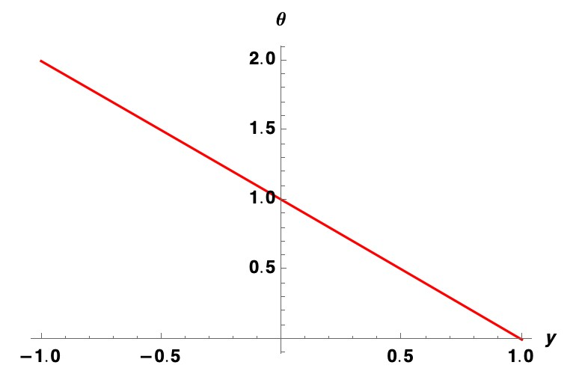

Figure 3 is drawn to analyze temperature distribution with the consideration of zero velocity slip for various with fixed values of M=0.5,$λ$=0.2, n=2, K=0.2, m=0, Ra=1, Re=1, Rd=0.1, Ec=0.01, Pr=1, P= -5.
Fig.3

Slide 16
Conclusions
An approximate analytical investigation of plane Poiseuille shear thinning fluid flow between two parallel horizontal walls via homotopic analysis. The walls are contained at different temperatures with no slip. The effects of various parameters are analyzed in graphical forms. The main findings are summarized as follows:
The velocity profile decreases with an increase in magnetic field parameter but expecting reverse trend to be occur in temperature distribution.
The velocity profile increases with an increase in time constant.
Temperature decreases linearly with y co-ordinate.

Slide 17
Future Work
We will be extending this to Carreau nanofluid considering Stefan blowing.
We have considered slip to be zero, in future we will analyze the effects including first and second order slip.
We will plot the temperature distribution by varying the various parameters like Time constant, Magnetic parameter, Reynold’s number and Prandtl’s number etc.

Slide 18
Thank You !

